Slide 1
Advanced Object Oriented Programming
Barcode Scanner
By
B V V L N BHARGAV (2110030150 )
JAINA VAMSHI (2110030153)
JATIN MISHRA (2110030212)
U SAI SUBRAHMANYAM(2110030293)
Under the guidance of
FIGLU MOHANTY

Slide 2
PROBLEM STATEMENT AND DOMAIN
Manual Entry of data is really hard as compared to barcode.
For easy identification of data we use barcode.

Slide 3
Advantages
Barcodes eliminate the possibility of human error. The occurrence of errors for manually entered data is significantly higher than that of barcodes. A barcode scan is fast and reliable, and takes infinitely less time than entering data by hand.

Slide 4
Solutions
Barcodes encode product information into bars and alphanumeric characters, making it much faster and easier to ring up items at a store or track inventory in a warehouse. Besides ease and speed, bar codes' major business benefits include accuracy, inventory control and cost savings.

Slide 5
Proposed Algorithm Design Technique
Barcode is a visual depiction of information in the form of bars and spaces on a surface.
This is an efficient algorithm, which can be further improved by adding angle correction method and can be provided to small grocery shops that cannot afford costly barcode scanners.

Slide 6
How is it suitable for your application
This saves a lot of time than manual calculation and also removes the possibility of human error. We have extensively tested our algorithm on challenging images and the accuracy is found to be above 60 percent.

Slide 7
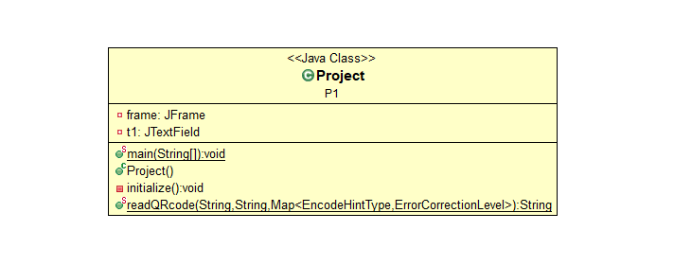
Class Diagram

Slide 8
Work Contribution
2110030150(B V V L N BHARGAV)- Report
2110030153(JAINA VAMSHI)- Java Program
2110030212(JATIN MISHRA)- Data Collection,Report
2110030293(U SAI SUBRAHMANYAM)- PPT

